Slide 1
Prismatic Heretic
By Sigma Squad: Dann Kaoussarani, Mohamad Ghanmeh, Dominique Cartier, Jennifer Osorio, Adrien Kamran, Le Cherng Lee
“Three swords, one heretic, no mercy”

Slide 2
Premise
2D top-down action game with RPG and roguelike features
Medieval setting, combined with fantasy and academia elements
Quick, real-time combat:
Switch between the three holy swords
Each sword can be used as a held weapon or a placed item
Can be used in conjunction for much greater results
Charming 2D pixel art style
Combines iconic elements of popular action games from the past decade, in a way that still manages to feel unique and fun

Slide 3
Story
Mage School where they believe in 3 religions:
Way of Blue
Crimson Court
Sunlight Council
Player is a purple mage that has been expelled
Steals the Holy Weapons of each religion
The player tries to escape the school while mastering the blades

Slide 4
Mechanics
Twin-stick movement and aim
Switching between 3 distinct weapons on the fly
Leaving weapons at certain location to be remotely activated
Color-coded enemy types, resistant to matching-color weapons

Slide 5
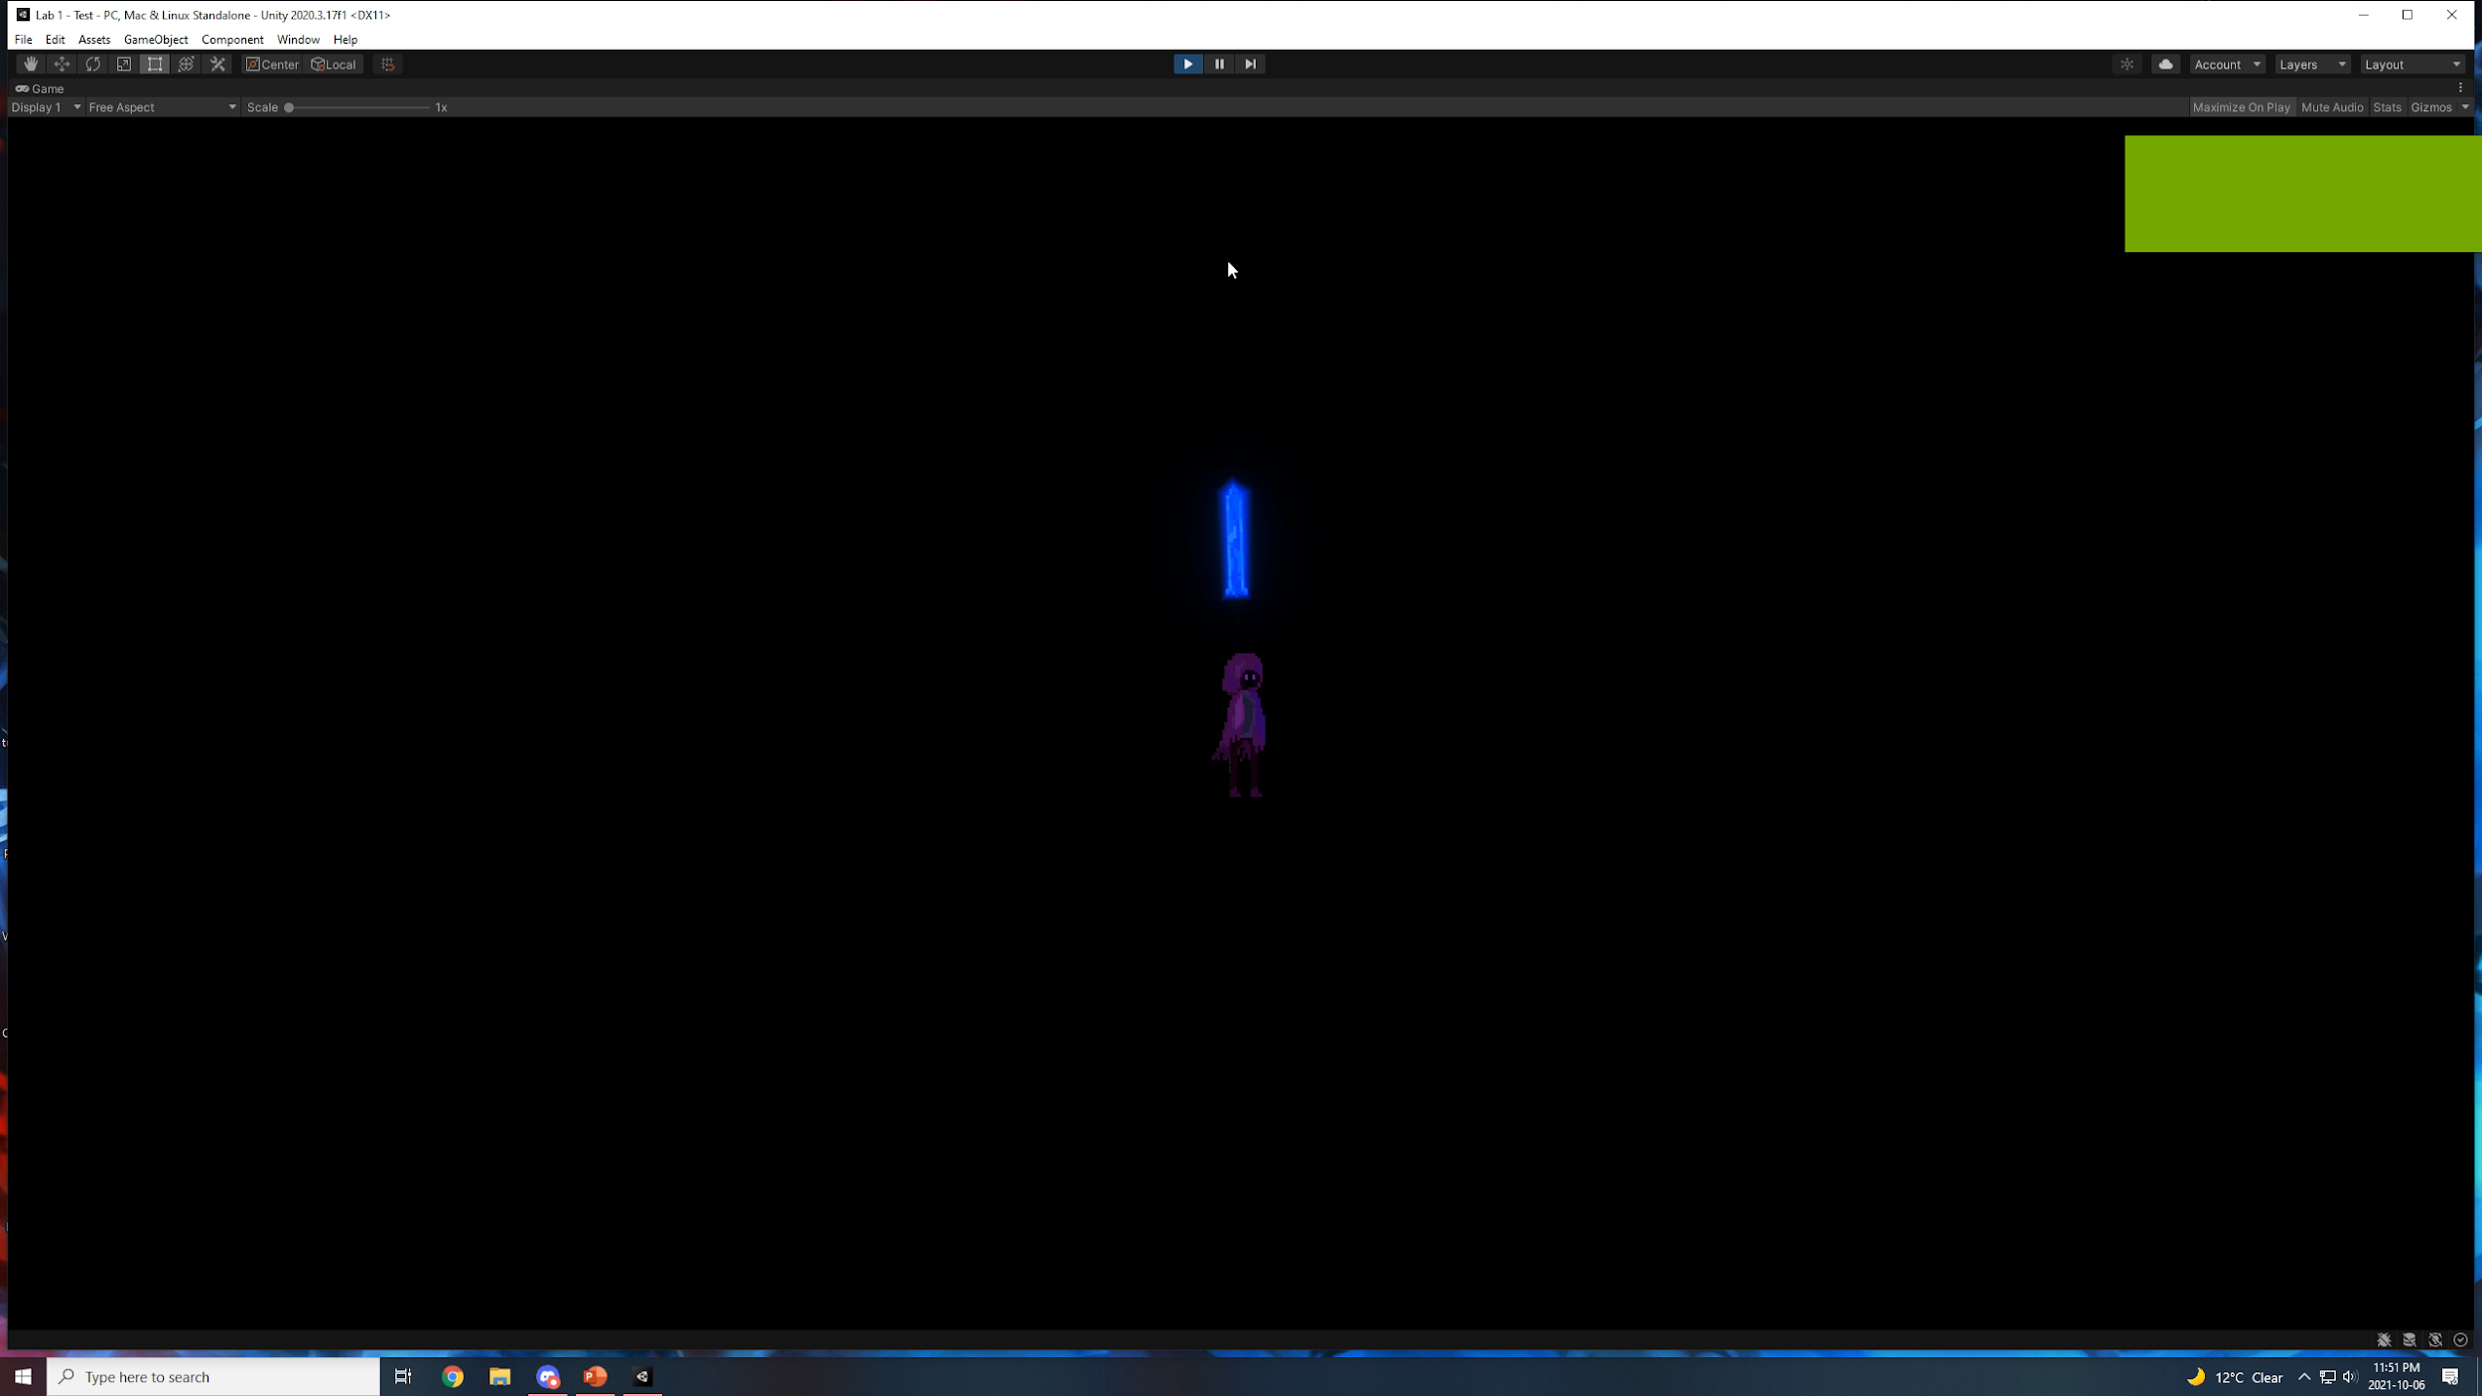


Slide 6
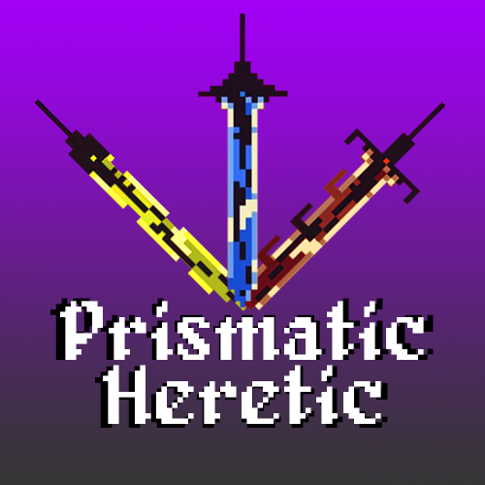
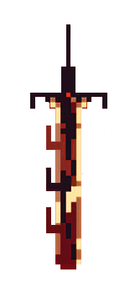
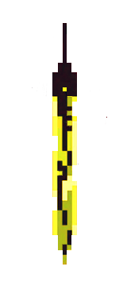
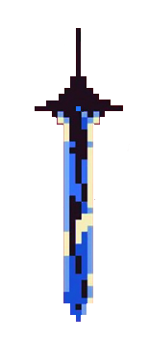
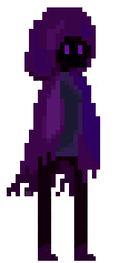
Art

Slide 7
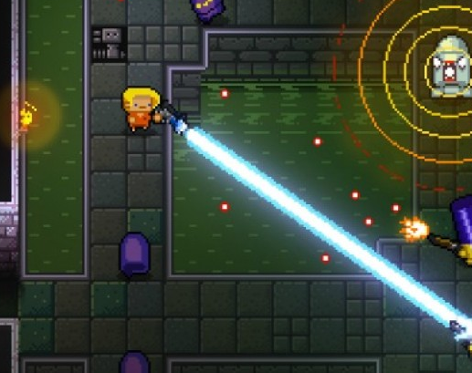
Enter the Gungeon
What is it?
Developed by Dodge Roll in 2016
Top-Down Roguelike Bullet Hell Shooter
Inspirations
Aiming mechanic

Slide 8
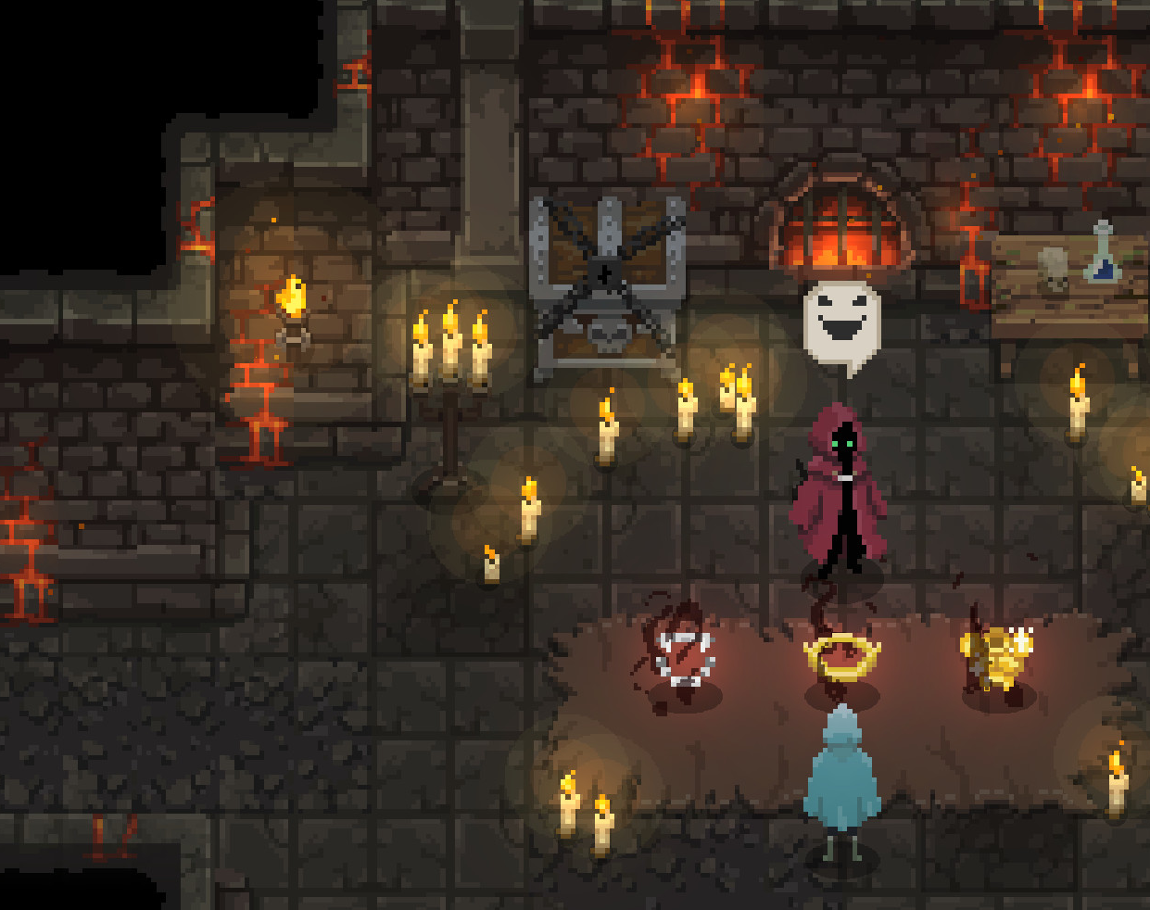
Wizard of Legend
What is it?
Developed by Contingent 99 in 2018
Top-Down Roguelike Spellcasting Action Game
Inspirations
Faced paced combat and intensity
Pixel-based art style and aesthetic
Close-ranged combat

Slide 9
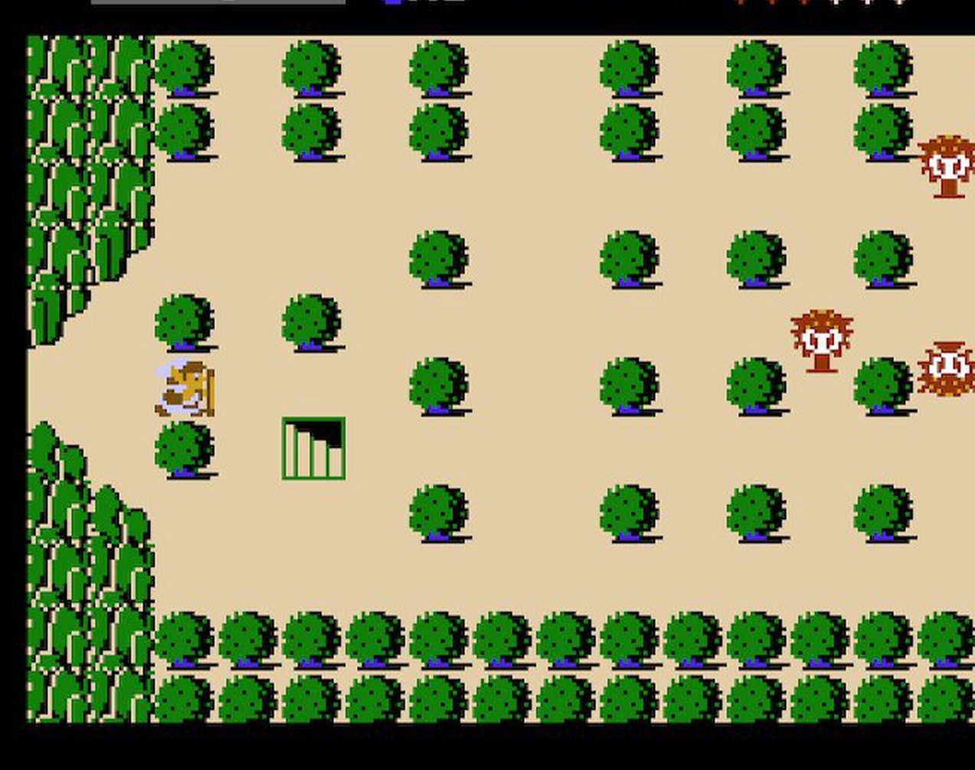
Legend of Zelda
What is it?
Developed by Nintendo for the NES in 1986
Top-Down Action-Adventure Dungeon Crawling Game
Inspirations
Character progression
Legacy

Slide 10
Roles
Character control and weapon mechanics:
Dann
Adrien
Dominique
Enemy AI and Level Design:
Lee
Jennifer
User Interface:
Mohamad

Slide 11
Roles
Asset Creation:
Mohamad
Adrien
Dominique
Music:
Lee

Slide 12
Thank you!

